Slide 1

Basic Syntax, Conditional Statements and Loops
SoftUni Team
Technical Trainers
Software University
https://softuni.bg

Slide 2
Table of Contents
Basic Syntax and First Steps
Conditional Statements
if, elif, else
indentation
and, or
Loops
2

Slide 3
Have a Question?
sli.do
#fund-python

Slide 4

First Steps

Slide 5
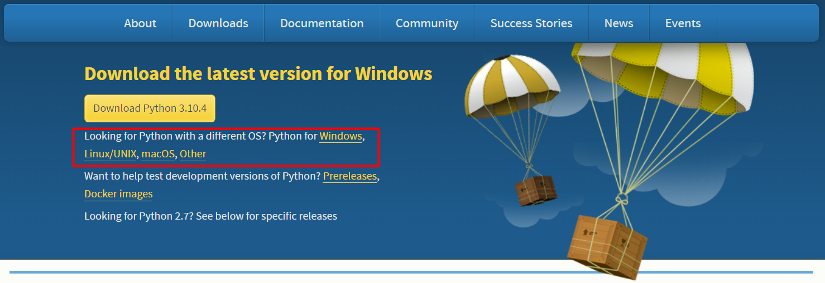
Installing Python
Go to python.org and click the download link depending on your operating system
5

Slide 6
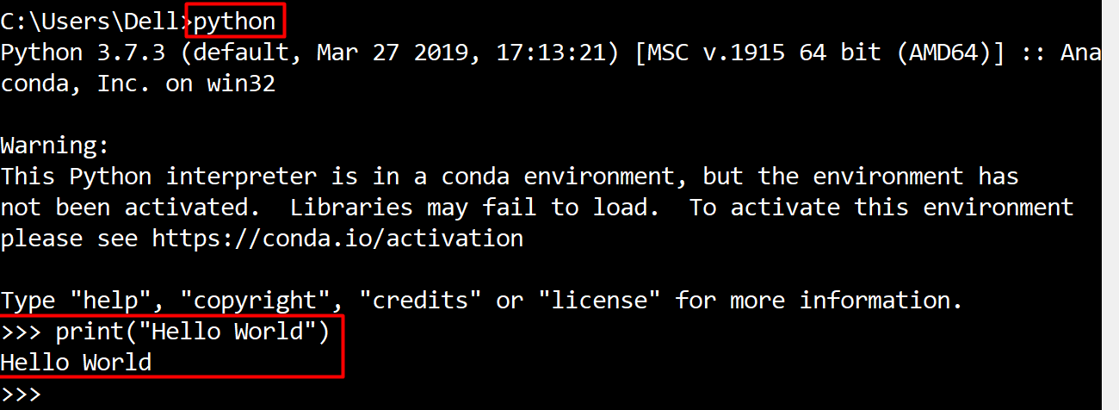
Run Python in Command Prompt
You can code and execute python directly in the command prompt by typing "python" or "py"
6

Slide 7
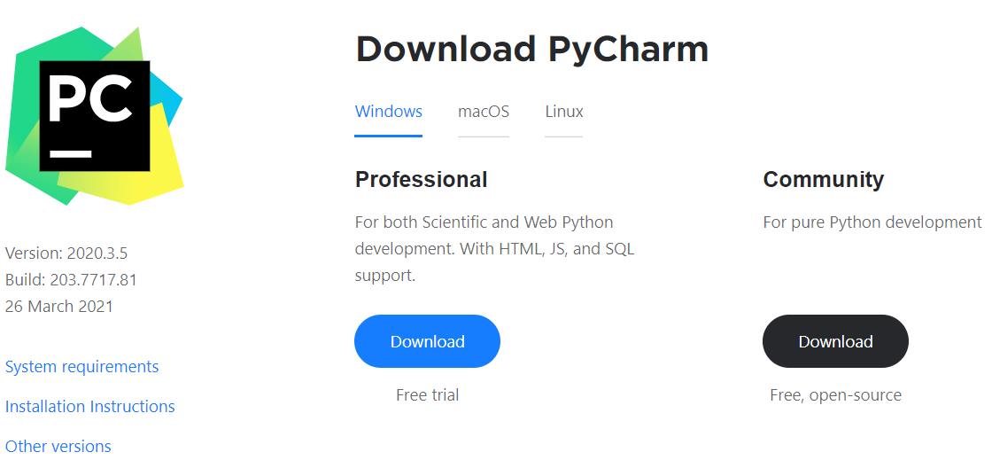
Write Python in IDE
You can also code in Python using IDE (for example: PyCharm)
You can download PyCharm from here: https://www.jetbrains.com/pycharm/download
7

Slide 8
Basic Syntax

Slide 9
Basic Syntax
Variables - they are way to store information and are characterized by name, type and value
Data types – variables are used to hold different data types
int - integer number: 1, 2, 3, 4, …
float - real number: 0.5, 3.14, -0.5, …
str - string and chars: "a", "Hello", …
bool - boolean: True, False
age = 25
Name
Value
9

Slide 10

Conditional Statements
Conditional Code Execution

Slide 11
The If-Statement (1)
An "if statement" is written by using the if keyword
a = 33
b = 200
if b > a:
print("b is greater than a")
11

Slide 12
The If-Statement (2)
Python supports the usual logical conditions from mathematics
Equals: a == b
Not Equals: a != b
Less than: a < b
Less than or equal to: a <= b
Greater than: a > b
Greater than or equal to: a >= b
12

Slide 13
Indentation
Python relies on indentation, using whitespace, to define scope in the code
Other programming languages often use curly-brackets for this purpose
If statement, without indentation will raise an error
a = 33
b = 200
if b > a:
print("b is greater than a") # error
13

Slide 14
The Else-Statement
The else keyword catches anything which isn't caught by the preceding conditions
a = 200
b = 33
if b > a:
print("b is greater than a")
else:
print("b is not greater than a")
14

Slide 15
The Elif-Statement
The elif keyword is pythonic way of saying "if the previous conditions were not true, then try this condition"
a = 33
b = 33
if b > a:
print("b is greater than a")
elif a == b:
print("a and b are equal")
15

Slide 16
Problem: Number Definer
Write a program that
Reads a floating-point number
Prints zero if the number is zero or otherwise prints positive or negative
Adds small if the absolute value of the number < 1, or large if the number > 1 000 000
25
positive
0.7
small positive
16

Slide 17

Solution: Number Definer
number = float(input())
if number == 0:
print("zero")
elif number > 0:
if number < 1:
print("small positive")
elif number > 1000000:
print("large positive")
else:
print("positive")
# TODO
17

Slide 18
Logical Operators
They are used to combine conditional statements
if a > b or a > c:
print("At least one of the conditions is True")
if a > b and c > a:
print("Both conditions are True")
if not a > c:
print("The condition is False")
18

Slide 19
Logical Operators Priority
or has a lower priority than and
and has a lower priority than not
if 2 > 1 or 3 < 4 and not 4 > 0:
print('This will be printed')
if (2 > 1 or 3 < 4) and not 4 > 0:
print('This will NOT be printed')
19

Slide 20
Check Number Range
If you want to check whether a number is in a given range, you can use the following syntax
a = int(input())
if 1 <= a <= 10:
print("a is in the range 1 and 10")
1 … 10
20

Slide 21
Problem: Largest of Three Numbers
Write a program which
Reads three whole numbers from the console
Prints the largest number
3
-1
5
5
0
-1
-2
0
21

Slide 22
Solution: Largest of Three Numbers
first_num = int(input())
second_num = int(input())
third_num = int(input())
if first_num > second_num and first_num > third_num:
print(first_num)
elif second_num > first_num and second_num > third_num:
print(second_num)
else:
print(third_num)
22

Slide 23

Loops
Repeating Blocks of Code

Slide 24
For-Loops
A for loop is used to iterate over sequence of iterable types like
string
list
other iterable types
The for loop does not require an indexing variable to set beforehand
24

Slide 25
The Range Function
To loop through a set of code a specified number of times, we can use the range() function
for x in range(3):
print(x)
# 0
# 1
# 2
25

Slide 26
Problem: Word Reverse
Write a program that
Receives a single word from a user
Reverses it and prints it
Python
nohtyP
26

Slide 27
Solution: Word Reverse
word = input()
reversed_word = ""
for i in range(len(word) - 1, -1, -1):
reversed_word += word[i]
print(reversed_word)
27

Slide 28
The Break Statement
The break statement stops the loop before it has looped through all the items
for x in range(3):
if x == 1:
break
print(x)
0
28

Slide 29
The Continue Statement
The continue statement skips the current iteration of the loop and continue with the next
for x in range(3):
if x == 1:
continue
print(x)
0
2
29

Slide 30
The Else Clause
The else clause is executed when the loop finishes iterating without hitting the break statement
for x in range(3):
if x == 3:
break
else:
print("Finish")
Finish
30

Slide 31
Problem: Even Numbers
Write a program that
Receives a number n and then receives n different numbers
If it receives an odd number, print "{num} is odd!" and end the program
If all numbers are even print "All numbers are even"
2
12
286
All numbers are even.
31

Slide 32
Solution: Even Numbers
n = int(input())
for i in range(n):
number = int(input())
if not number % 2 == 0:
print(f"{number} is odd!")
break
else:
print("All numbers are even.")
32

Slide 33
While-Loops
With a while loop we can execute a set of statements as long as the condition is true
Note: remember to increment i, or else the loop will continue forever
i = 1
while i < 6:
print(i)
i += 1
33

Slide 34
Problem: Number Between 1 and 100
Write a program that
Reads floating-point numbers from the console until it receives a number between 1 and 100 inclusive
When the correct number is received, stop reading and print "The number {number} is between 1 and 100"
-3
0.9
44
The number 44 is between 1 and 100
34

Slide 35
Solution: Number Between 1 and 100
number = float(input())
while not (1 <= number <= 100):
number = float(input())
print(f'The number {number} is between 1 and 100')
35

Slide 36
Problem: Shopping
Write a program that
Reads a budget and then prices of each product you need to buy until it receives the command "End"
If there is not enough budget left for the next product, prints "You went in overdraft!" and end the program
If you bought everything needed and the program receives "End", prints "You bought everything needed."
100
5
End
You bought everything needed.
36

Slide 37
Solution: Shopping
budget = int(input())
command = input()
while command != "End":
product_price = int(command)
budget -= product_price
if budget < 0:
print("You went in overdraft!")
break
command = input()
else:
print("You bought everything needed.")
37

Slide 38

Live Exercises

Slide 39

Summary
…
…
…
We learned how to:
Execute code based on different conditions
Use loops to execute a block of code multiple times on different elements
Stop/skip iterations in loops

Slide 40
Questions?
Notes:
40

Slide 41












SoftUni Diamond Partners

Slide 42


Educational Partners

Slide 43

License
This course (slides, examples, demos, exercises, homework, documents, videos and other assets) is copyrighted content
Unauthorized copy, reproduction or use is illegal
© SoftUni – https://about.softuni.bg
© Software University – https://softuni.bg
Notes:
43

Slide 44
Trainings @ Software University (SoftUni)
Software University – High-Quality Education, Profession and Job for Software Developers
softuni.bg, about.softuni.bg
Software University Foundation
softuni.foundation
Software University @ Facebook
facebook.com/SoftwareUniversity
Software University Forums
forum.softuni.bg
Notes:
44

